Slide 1
Amazon QA Conversation Analysis
Team 10
Tianran Huang, Jialu Liu, Lisha Xia,
Xiaochen Yan, Shiqin Zeng, Zhongyan Zheng

Slide 2
Overview
Project Motivation and Goals
Data Collection and Data Characteristics
Machine Learning Tools and Model Selection
Data Mining
Results and Property Assessment
Enterprise Discussion
Conclusion and Future Work

Slide 3
Project Motivation & Goals

Slide 4
Project Motivation & Goals
Motivation
Goals
Understanding Customer Interactions
Engagement and Decision Making
Seller-Customer Interaction
Insight and Pattern Discovery
Research and Academic Value
Data Mining for Sentiment Analysis and Topic Modeling
Constructing a Classification Model
Scalability and Adaptability
Notes:
Motivation
Understanding Customer Interactions: Analyze the questions and answers on Amazon to understand how customers interact with products, particularly in the "Health and Personal Care" category.
Engagement and Decision Making: Help potential buyers make informed decisions through enhanced engagement in the QA sections.
Seller-Customer Interaction: Allow sellers to address concerns, provide additional product information, and clarify doubts directly with customers.
Insight and Pattern Discovery: Reveal hidden patterns and insights within customer conversations to improve engagement strategies, feedback loops, and information accuracy.
Research and Academic Value: Explore social dynamics, communication styles, and linguistic trends for academic research and insights.
Goal
Data Mining for Sentiment and Topics: Utilize sentiment analysis and topic modeling on product-related QA sections to understand emotions, themes, and issues driving customer discussions.
Constructing a Regression Model: Develop a regression model to predict the overall feedback score based on quantified features from customer conversations, aiding in the identification of helpful responses and assessing response quality.
Scalability and Adaptability: Design a model pipeline scalable to various product categories on Amazon, employing state-of-the-art techniques for broad applicability.

Slide 5
Data Collection &
Data Characteristics

Slide 6
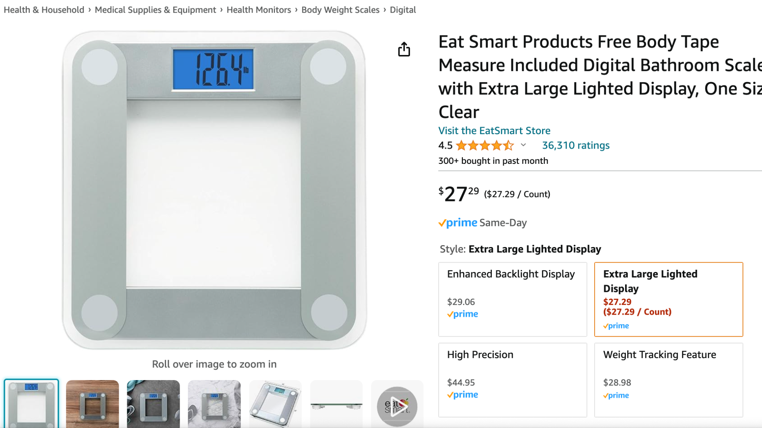
Data Collection
Two primary datasets from Amazon are utilized
(Collected by McAuley and colleagues via web scraping):
Amazon Question/Answer Data
Contains approximately 1.4 million Question and Answer entries.
Covers 21 product categories, specifically using the "Health and Personal Care" subcategory for the research.
Amazon Product Data
Comprises 142.8 million reviews collected from May 1996 to July 2014.
Includes product metadata and links related to product interaction (e.g., products also viewed and bought).

Slide 7
Additional Chart Layouts Examples
QA Data Features:
Product Review Data Features
asin: Product ID.
questionType: Indicates the nature of the question.
answerType: Types include 'Y' for yes, 'N' for no, and '?' for indeterminate.
answerTime: Raw timestamp of the answer.
unixTime: Converted Unix timestamp of the answer.
question: Text of the question.
answer: Text of the answer.
reviewerID: ID of the reviewer.
asin: Product ID.
reviewerName: Name of the reviewer.
helpful: Helpfulness rating of the review.
reviewText: Text of the review.
overall: Product rating.
summary: Summary of the review.
unixReviewTime: Review time in Unix format.
reviewTime: Raw review time.

Slide 8
Machine Learning Tools & Model Selection

Slide 9
Sentimental Analysis & Topic Modeling
What are Sentimental Analysis & Topic Modeling?

Slide 10
Tools and Models
Sentiment Analysis
Lexicon-based: Utilizes a predefined dictionary of words with assigned sentiment values to calculate overall sentiment scores.
Machine Learning-based: Trains models on labeled data to predict sentiments of new data.
Deep Learning: Employs neural networks to capture deeper linguistic patterns for more accurate sentiment predictions.
Topic Modeling
Data Preparation: Involves cleaning, tokenization, removal of stopwords, and normalization of texts.
Feature Extraction: Uses Bag of Words (BOW) and Term Frequency-Inverse Document Frequency (TF-IDF) methods.
Modeling: Applies Latent Dirichlet Allocation (LDA) to uncover underlying topics in the text data.

Slide 11
Tools and Models Cont.
Classification Models
Random Forest Classification: Uses multiple decision trees to improve classification accuracy and assess feature importance.
Adaboost: Combines multiple weak classifiers to create a strong classifier.
GBDT: incrementally build a model by iteratively adding decision trees to correct errors from previous models, ultimately creating a highly accurate prediction model.
Support Vector Machines (SVM) and Multi-Layer Perceptrons (MLP): Employed for categorizing reviews into different classes based on extracted features from topic modeling and sentiment analysis.
Model Evaluation
Metrics such as precision, recall, F1 score, and accuracy are used to evaluate the models.
Cross-validation is employed to ensure the model’s robustness and generalizability.

Slide 12
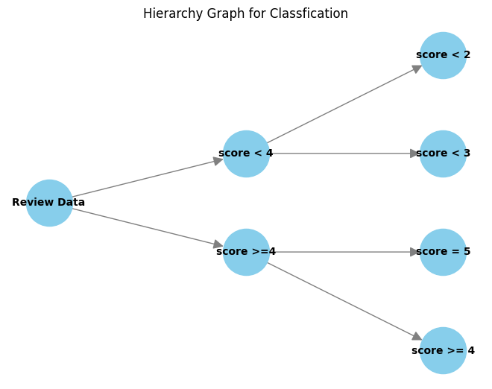
Tools and Models Cont.
Hierarchy Classification
Established a hierarchical structure with three stages
Stage 0: Review Data
Stage 1: score<4 and score>=4
Stage 2: classify each of classes in stage 1 into 2 classes
Assign priority to cases with a high probability of a rating score under 4
A supplementary model to optimize the response service from the merchant

Slide 13
Data Mining Strategies

Slide 14
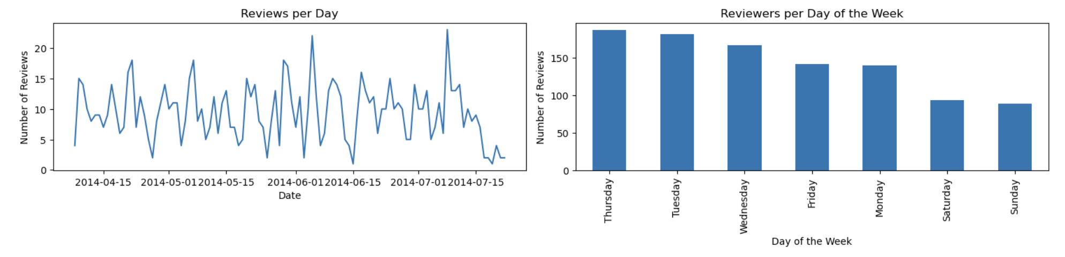
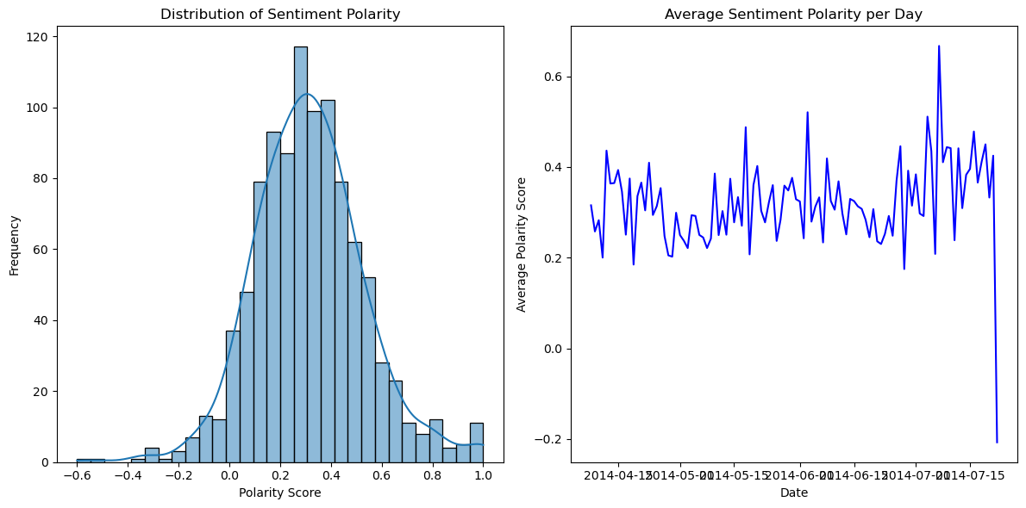
Data Mining
Data Preprocessing
Large Scale Dataset
Extract the particular product (“asin”)
Exploratory Data Analysis
Reviewer activity visualization
Sentiment Polarity visualization
Feature Engineering
Time: Convert to Datetime format
Helpful: Convert to numeric format to evaluate the quality of the answer
Sentiment Analysis: Assigning polarity score with each comment, and get the sentiment polarity classification label

Slide 15
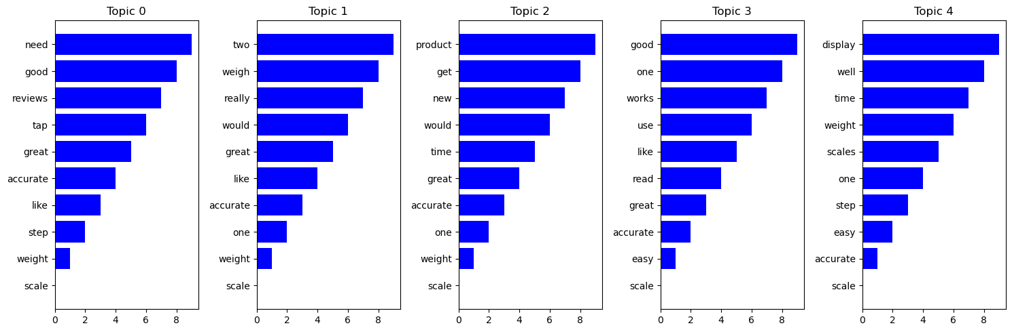
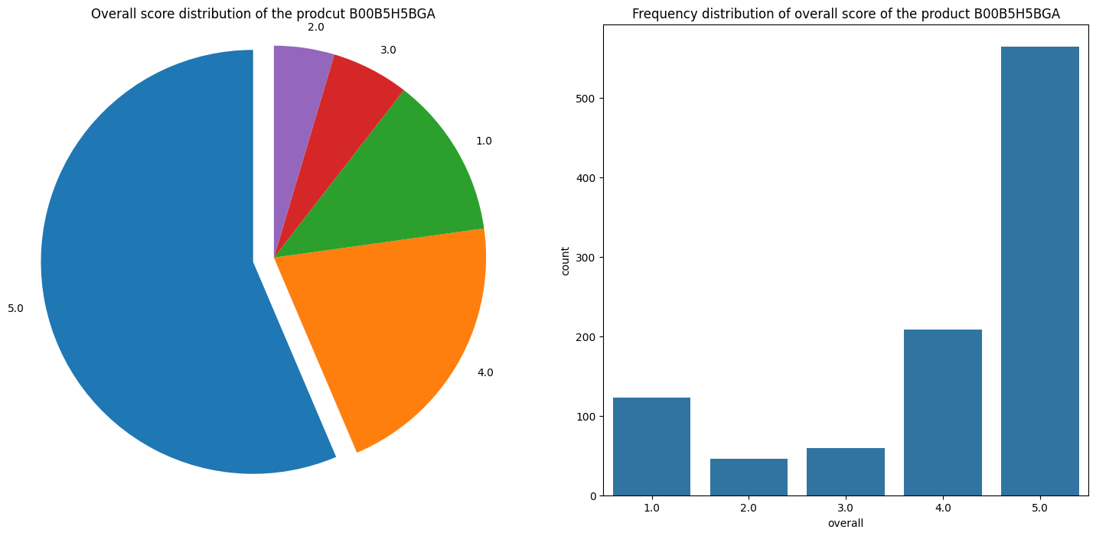
Data Mining
Topic Modeling
Text Preprocessing
Creating Dictionary and Corpus
Using LDA model to extract the Topic
Data Cleaning & Export
A subset of relevant columns is selected and saved to a new data file
Data Partition
train_test_split function
randomly split the dataset into training data and testing data

Slide 16
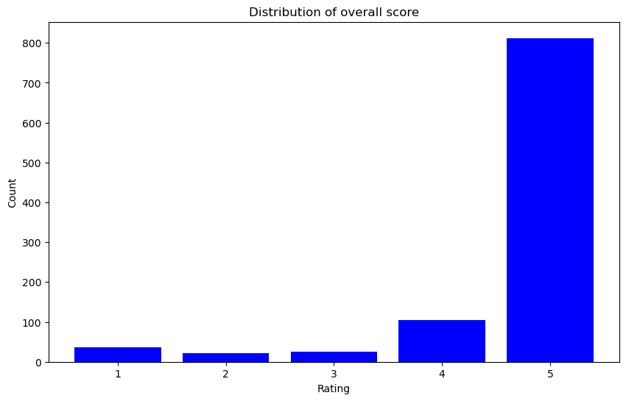
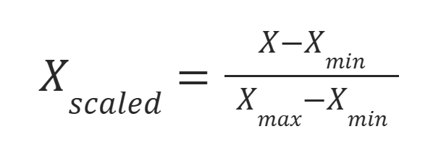
Data Mining
Normalization
MinMaxScaler: ensures the numerical values of different features are consistent
Oversampling for Handling Imbalanced
Balance the dataset
SMOTETomek Algorithm:
Generate synthetic samples
Remove overlapping samples between synthetic and majority class samples
Grid Search
Evaluates the performance of each parameter combination using cross-validation

Slide 17
Results &
Property Assessment

Slide 18
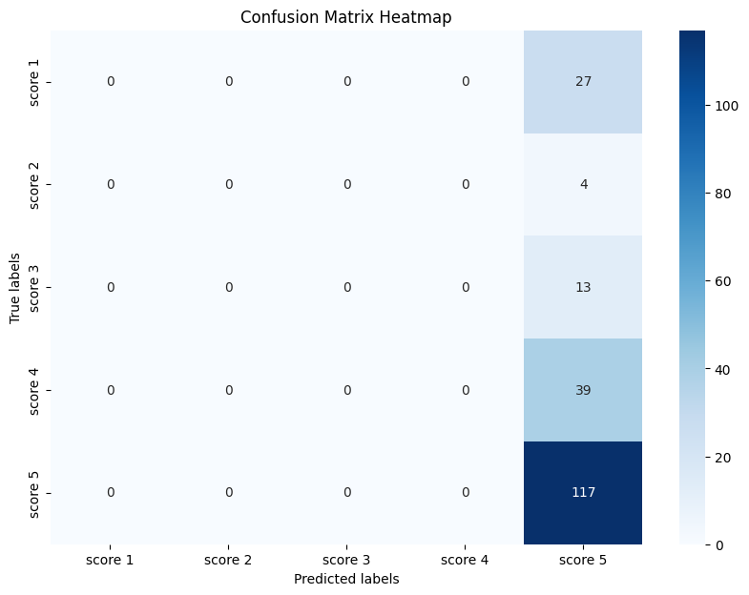
Results of SVC
Metrics | Result
Weighted Avg Precision | 0.3422
Weighted Avg Recall | 0.585
Weighted Avg F1-Score | 0.4318
Macro Avg F1-Score | 0.1476
Performs well on categorizing class 5 with high recall
Performs poorly for the other classes 1 to 4

Slide 19
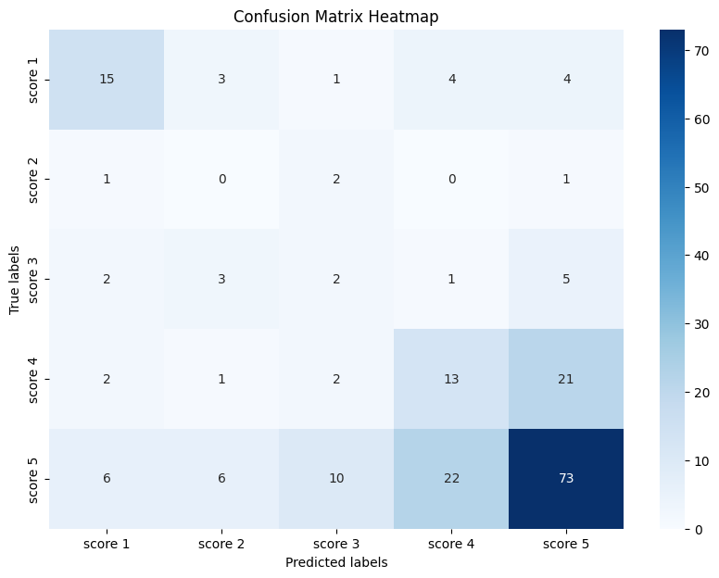
Results of Adaboosting
Metrics | Result
Weighted Avg Precision | 0.5595
Weighted Avg Recall | 0.515
Weighted Avg F1-Score | 0.5357
Macro Avg F1-Score | 0.3378
Outperforms SVC
Performs relatively well on classes 1 and 5
Have difficulty recognizing classes 2, 3 and 4.
The overall accuracy is low (51.5%)

Slide 20
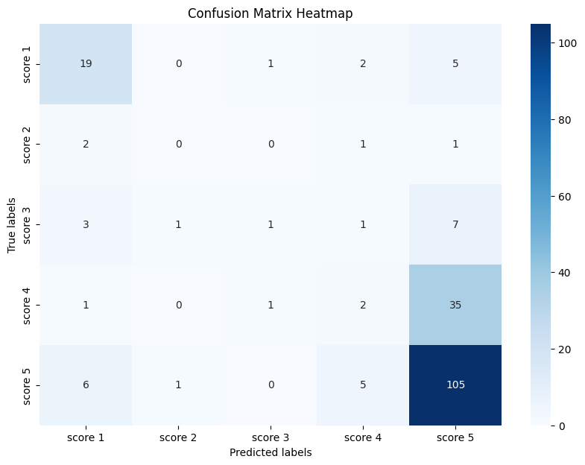
Results of GBDT
Metrics | Result
Weighted Avg Precision | 0.5413
Weighted Avg Recall | 0.635
Weighted Avg F1-Score | 0.5672
Macro Avg F1-Score | 0.3276
Good recognition ability for class 1
Strong recognition ability for class 5
Still limited in its ability to recognize classes 2, 3 and 4

Slide 21
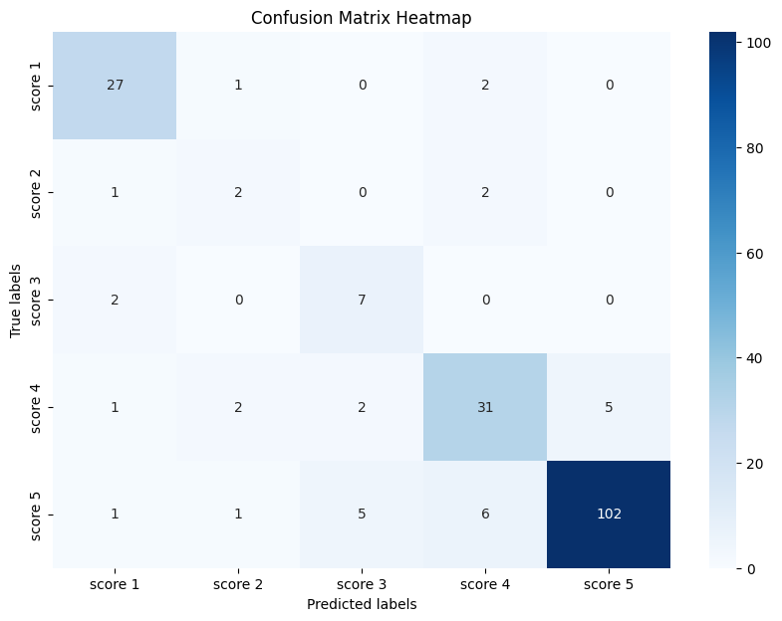
Results of Random Forest
Metrics | Result
Weighted Avg Precision | 0.8605
Weighted Avg Recall | 0.845
Weighted Avg F1-Score | 0.8505
Macro Avg F1-Score | 0.7037
Performs best among all models
High precision, recall, and F1 scores on most of the classes
High Macro average shows a more balanced and robust performance.

Slide 22
Hierarchy decision tree Results
Class | <2 | <3 | <4 | >=4 | =5
Accuracy | 0.895 | 1.0 | 0.97 | 0.925 | 1.0
Mean Cross-Validation Accuracy | 0.9200 | 1.0 | 0.92875 | 1.0 | 0.755
Classes "<3" and "≥4" achieve perfect accuracy and cross-validation scores,.
Class "<2" shows high consistency with accuracy above 0.89 and the highest cross-validation score among the non-perfect classes.
Class "=5" exhibits a significant discrepancy with perfect accuracy but much lower cross-validation accuracy.

Slide 23
Conclusion, Enterprise Discussion, & Future Work

Slide 24
Conclusion
Effectively analyzed customer conversations and predicting product feedback scores.
The Random Forest model outperforms Support Vector Machine, GBDT, and AdaBoost.
Sentiment analysis and topic modeling provide insights into customer emotions, concerns, and key themes driving product discussions.
Classified the products based on different topic distributions from the topic modeling result.

Slide 25
Enterprise Discussion
Valuable for e-commerce enterprises, especially with health and personal care products
Enable businesses to gain insights into customer sentiments, concerns, and overall satisfaction
Help enterprises address concerns, improve product descriptions, and provide targeted support
Product score prediction assists businesses in identifying areas for improvement and prioritizing efforts

Slide 26
Future Plan
Developing a chatbot that uses insights from data mining techniques, text analysis, and predictive machine learning models
The chatbot could provide personalized responses to customer questions based on identified topics and sentiments.
Integration of the existing chatbot with the Amazon QA system, improving user experience and reducing business workload.
Incorporating advanced NLP techniques, such as deep learning-based models, to improve accuracy and understanding of customer conversations

Slide 27
Thank you !

